Slide 1
Market Place App
Phil Harper

Slide 2

Baby Clothes Bazaar

Slide 3
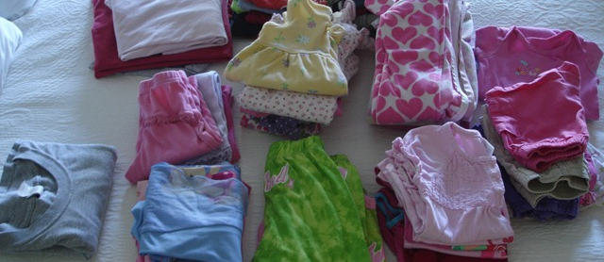
The Problem!

Slide 4
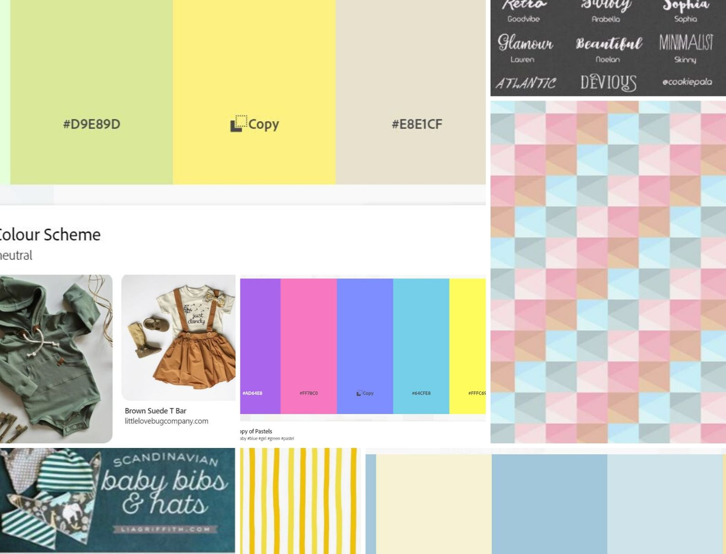
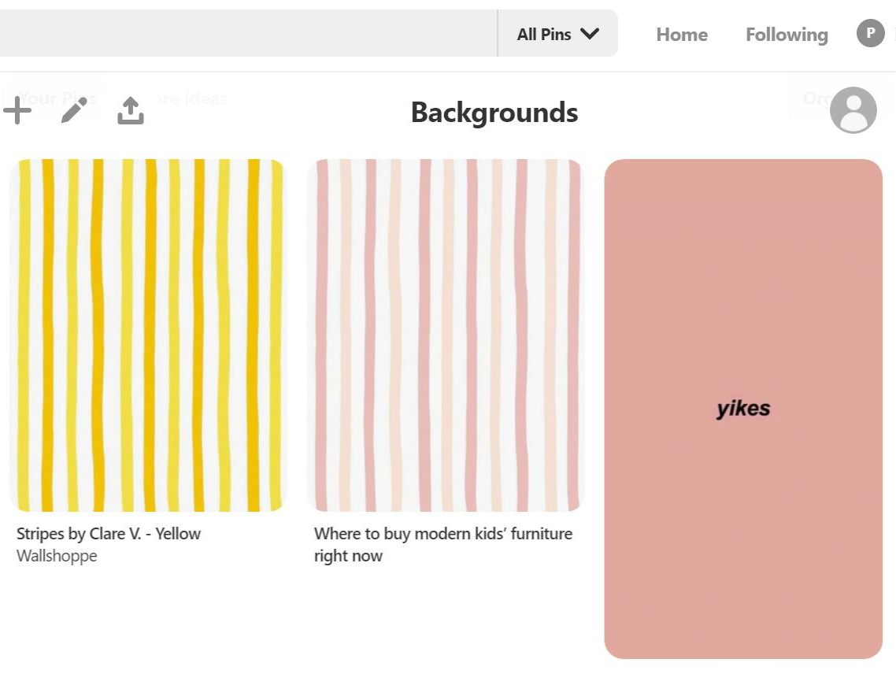
Brainstorming
Moodboard
Themes

Slide 5
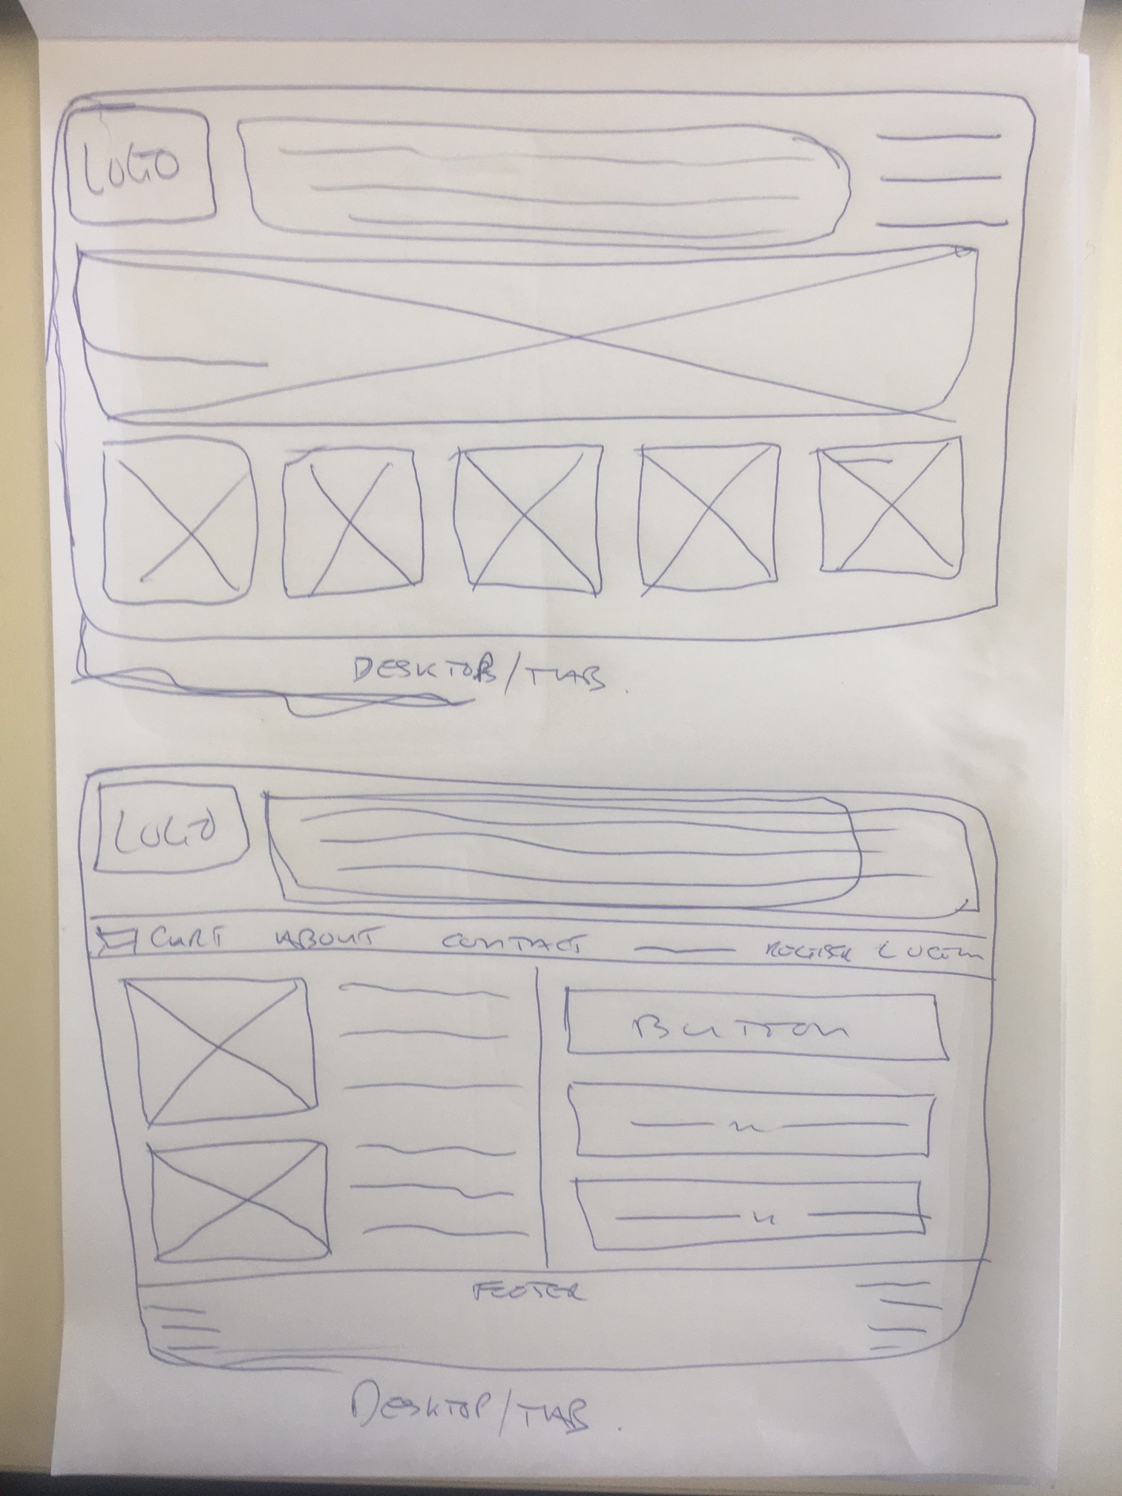
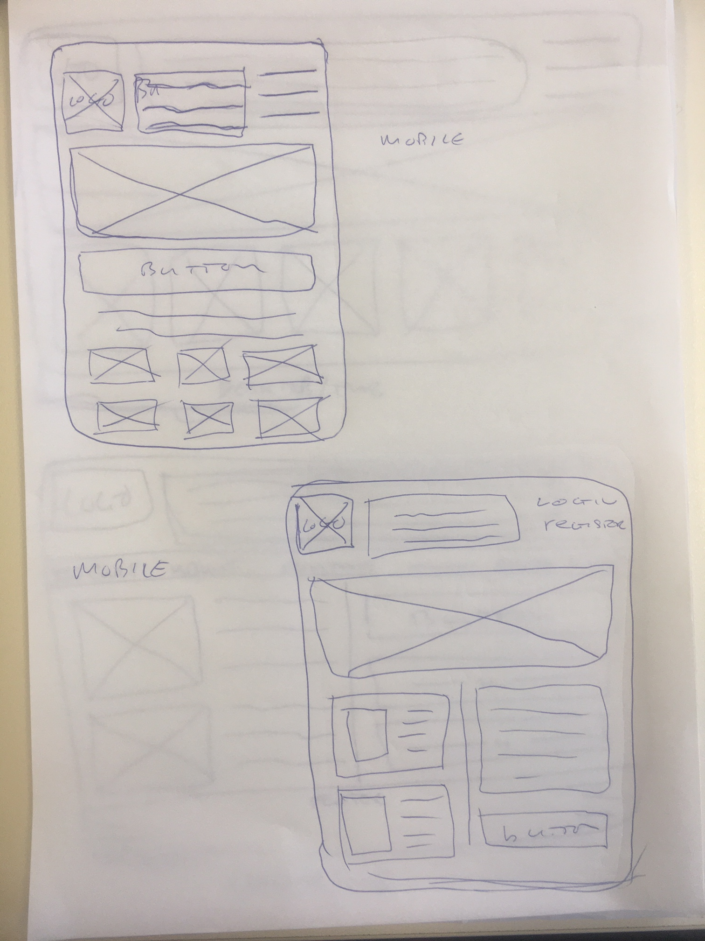
Wireframes

Slide 6
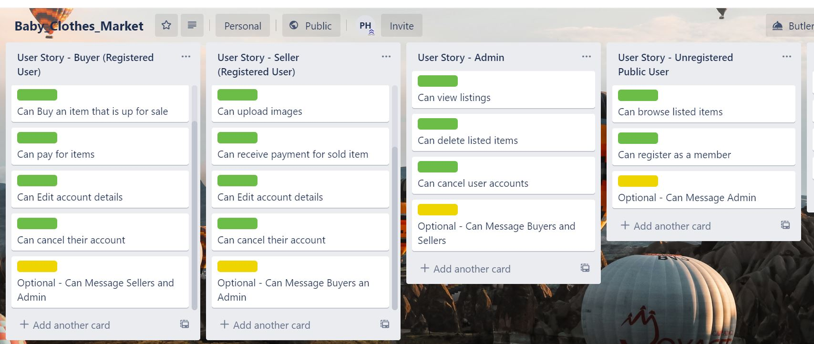

Slide 7
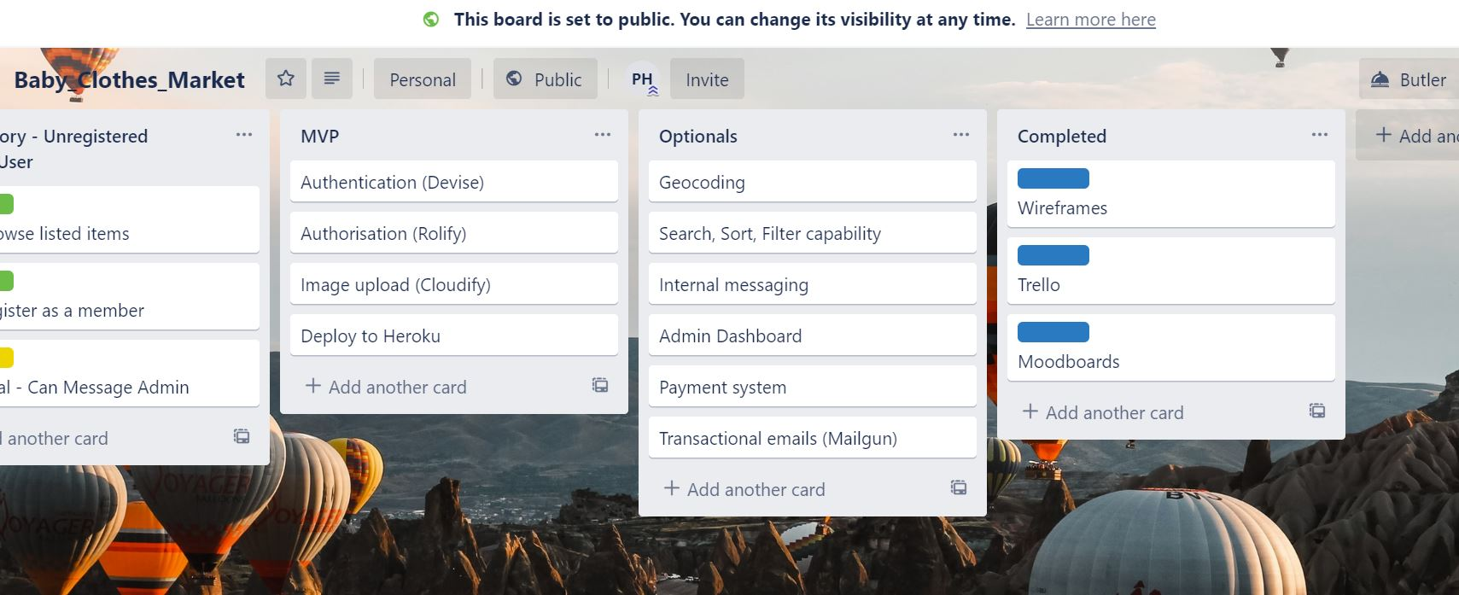

Slide 8
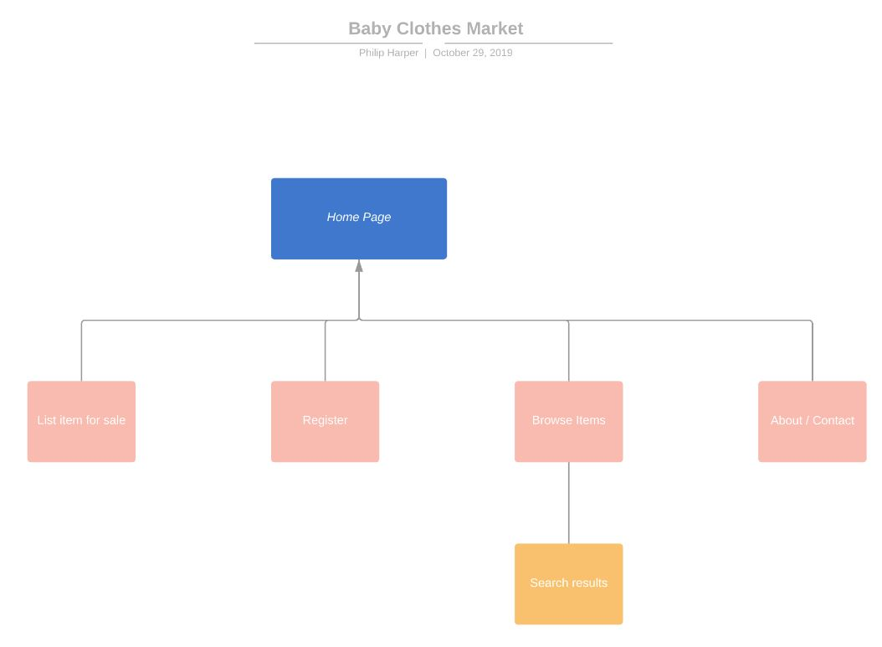

Slide 9
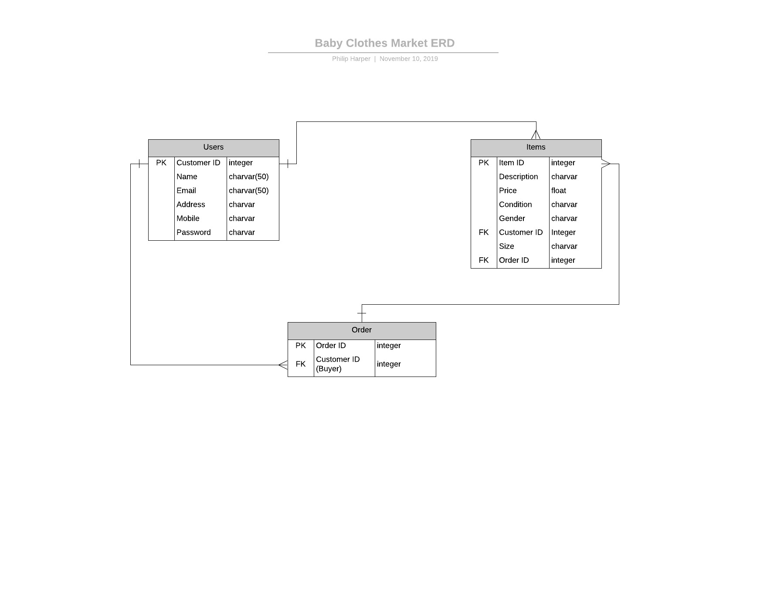

Slide 10
Functions
Image Upload
Implement payment system
Sign-Up/Login Functionality
Authenticate User
Authorise Users
Add, edit and list own items
List all Items

Slide 11
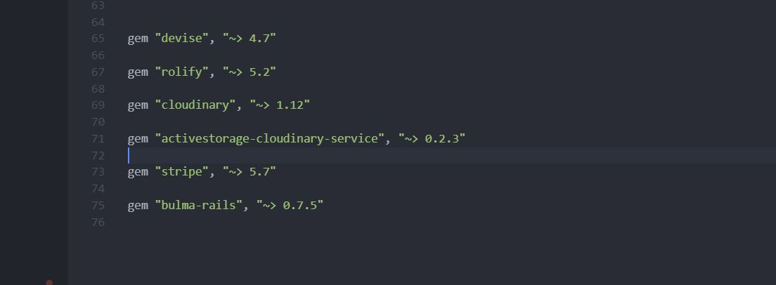

Slide 12
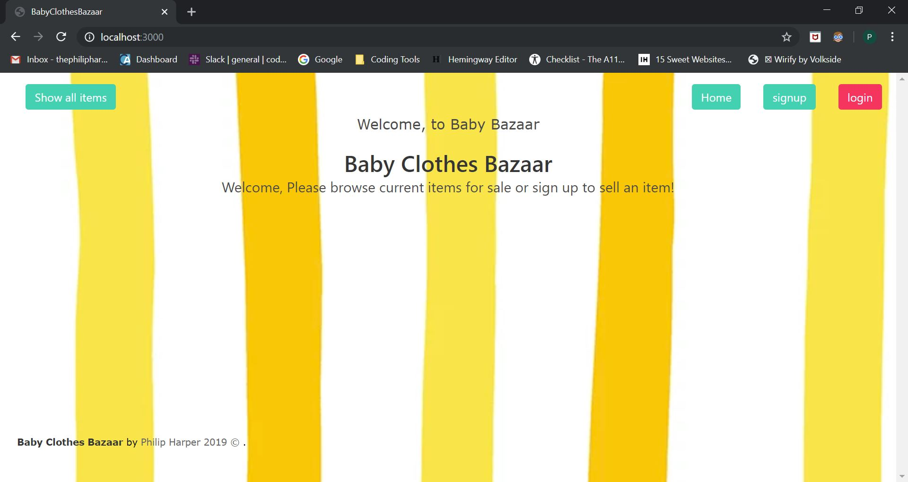

Slide 13
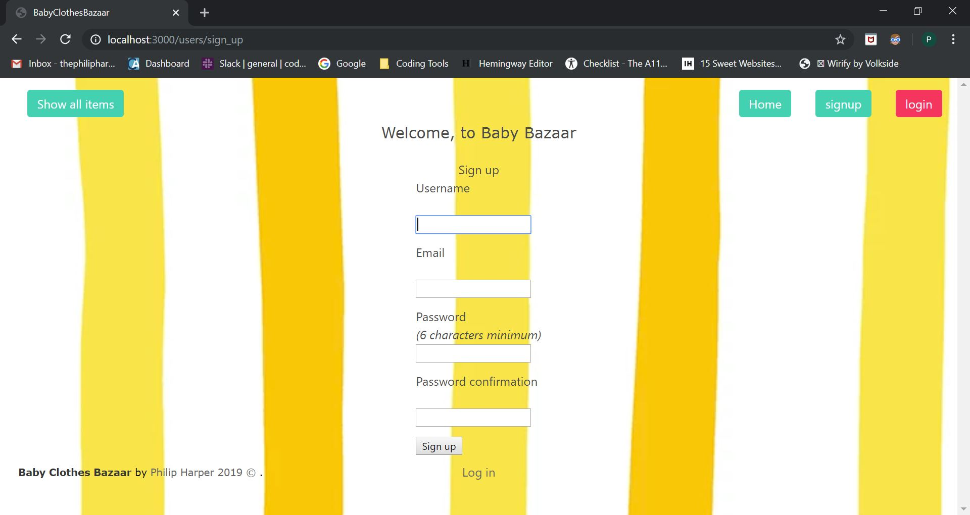

Slide 14
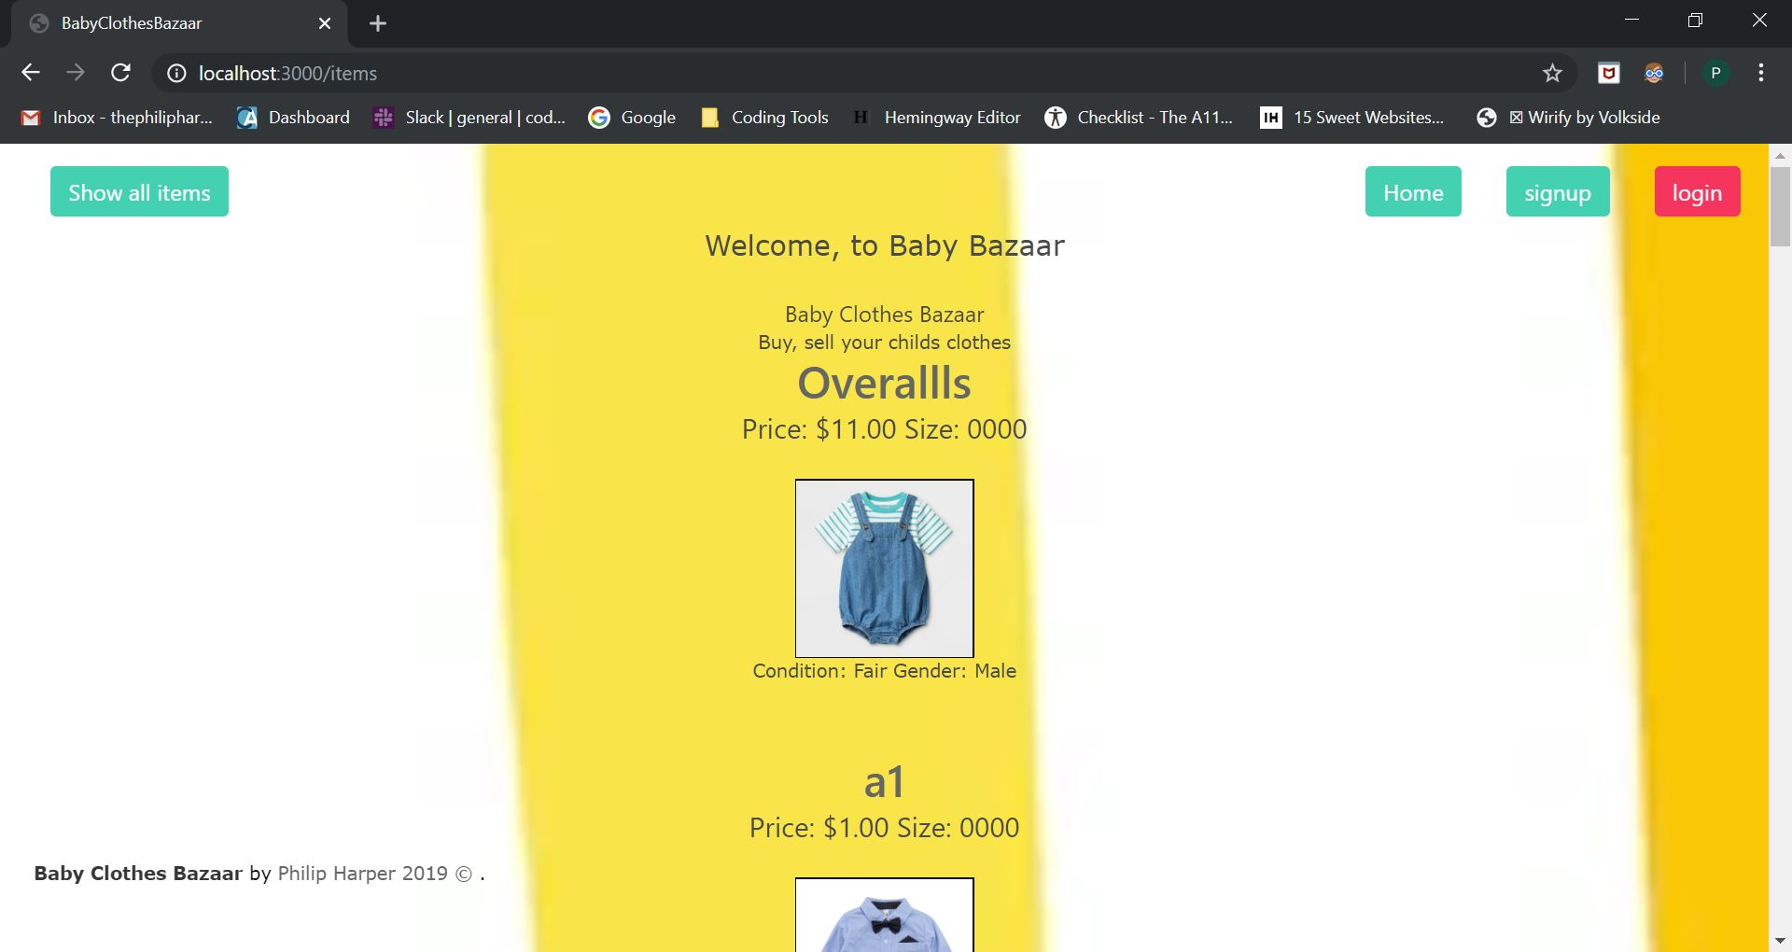

Slide 15
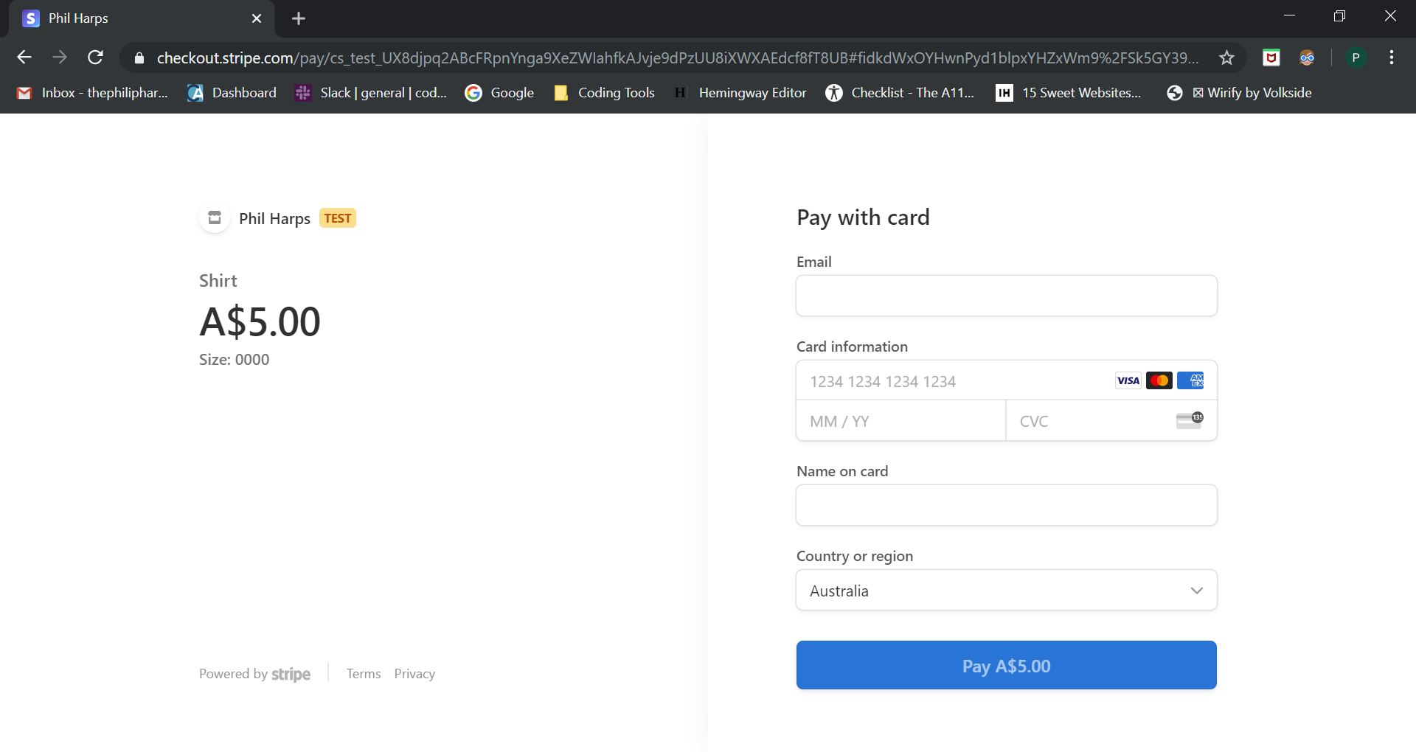

Slide 16
Future Functions
Search option (Able to search by size)
Messenger (Byer and Seller able to message each other)
Transactional emails (Sign-Up, Buying Confirmation, etc)
Admin Dashboard

Slide 17


Slide 18


